Slide 1

Yalla Shabab
Done By :
Israa Mazaraa
Tamara Refaee

Slide 2
Yall Shabab
Yalla Shabab is your go-to platform for organizing impactful events and courses, bringing together professors, students, and companies from around the world—with a special focus on supporting Palestine during times of conflict. Since our inception in 2025, our mission has been to bridge the gap between education and industry by offering exceptional opportunities for skill development, collaboration, and innovation. We are committed to empowering communities and providing crucial support where it is needed most, ensuring that progress and learning continue even in the face of adversity."
our goal is to expand globally. Additionally, we can create a newsletter page for our partners, allowing them to share their posts and news.
Learning Management system that allowable for teacher post their training Material .

Slide 3
Our Environment
Our environment includes a web API built on a Spring Boot application and a frontend built with React, using libraries such as Tailwind CSS and Axios and others.

Slide 4
Our website
We have two part of our website
"Education Hub" or "portal "
We have four different user:
1.suoper Admin /Admin
2.Student
3.Instuctor
4.Organziation / partners

Slide 5
Users
Super admin : can has full permission on our website (e.g Add Admin)
Admin : can adding Instructor, training, Organization
Instructor and organization can added by Admin or super admin
And no sign up for them .

Slide 6
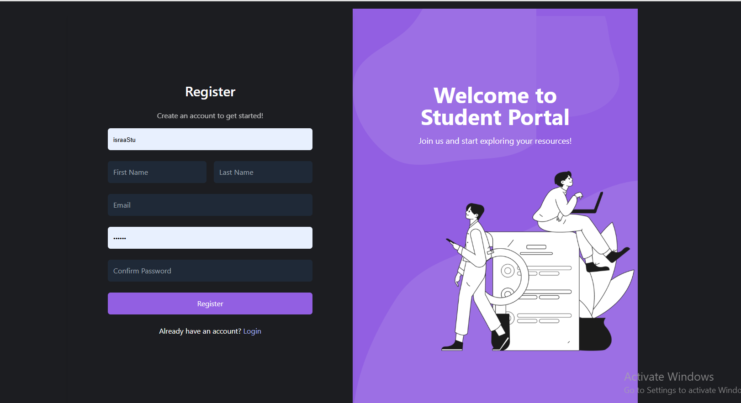
Student
Student: only Students can make sign up from our website

Slide 7
Training
Our training can be Event or Courses
It added by Admin or super Admin on portal
We can have more than one organization more than one Instructor for
Training.
We have reached the maximum number of enrolled students, so we cannot add any more. However, the Super Admin can add students if necessary.
We can delete event and delete soft delete for registration student and other entity that related.

Slide 8
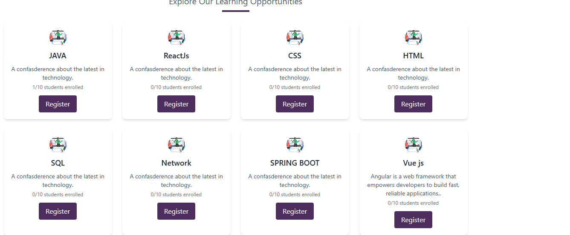
Only Student can register for training

Slide 9
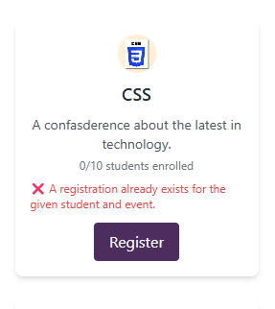
If the student already register for the training it's not allowed to make new registration
Without register student we can't
register for any training so our page
will take u to login page .

Slide 10
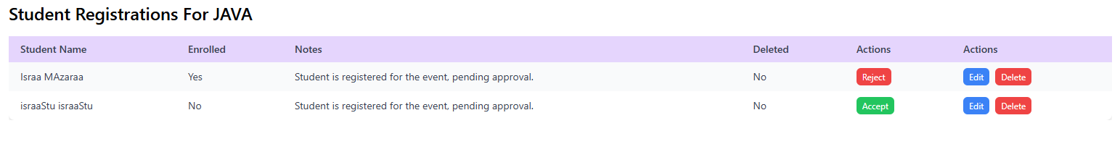
Accept or reject Student registration
The admin and super admin can accept student for specific training

Slide 11
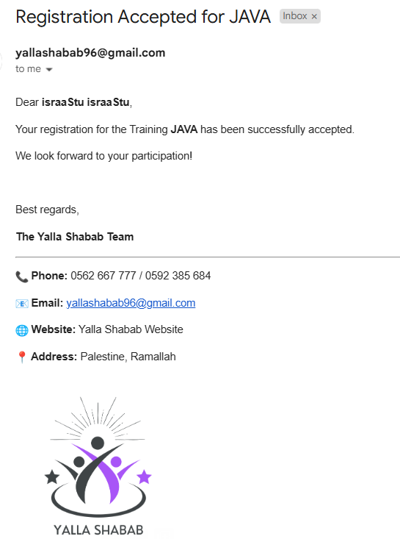
Email
An email will send for student
when he/she was acceptable for training
As backend sevice

Slide 12
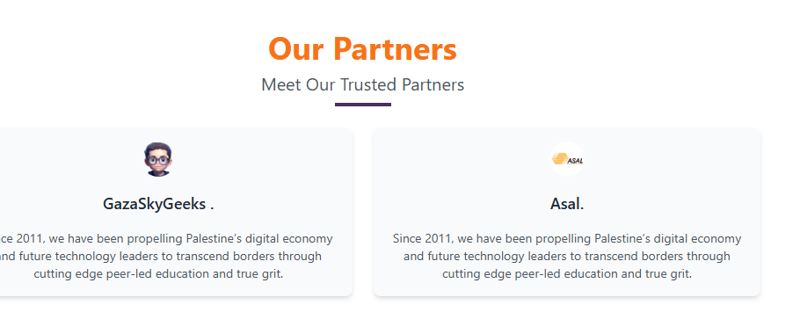
Our Partner
We can add organizations as our partners.
These partners could serve as instructors
for our training programs, or they
might require services such
as providing graduated students
for their job openings.

Slide 13
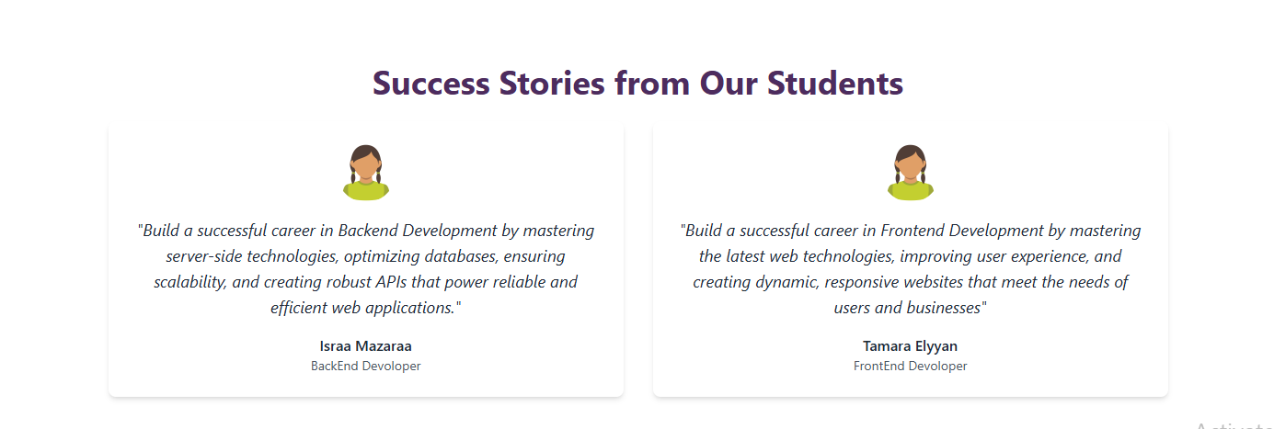
Our Success Story
We special section called success story that show success story of students
But now
isn't dynamic
we have it
as static

Slide 14
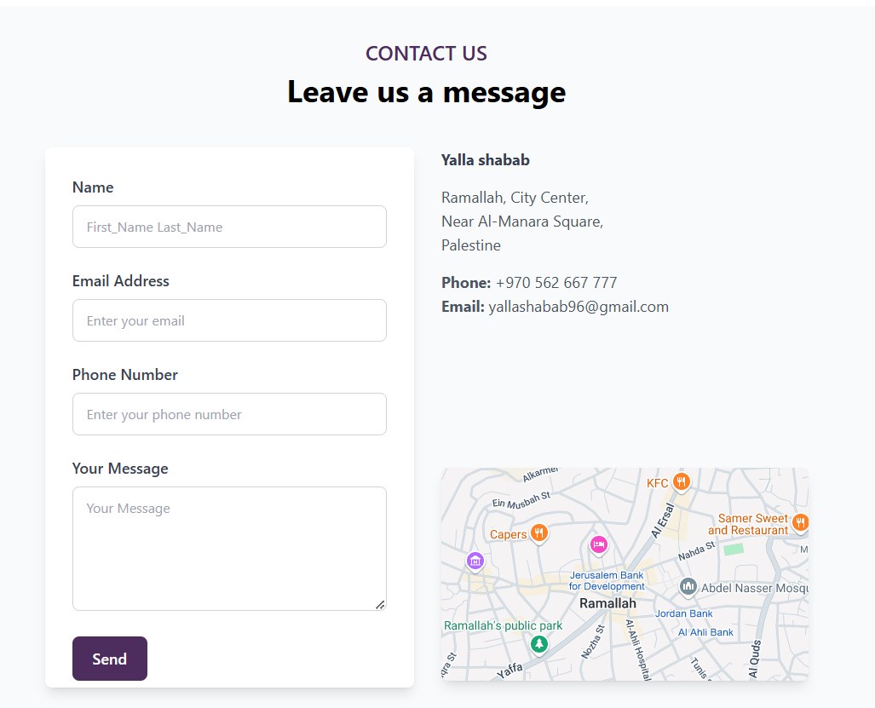
Contact page
The user will send email from email.js
As front end .
To make comment and support.

Slide 15
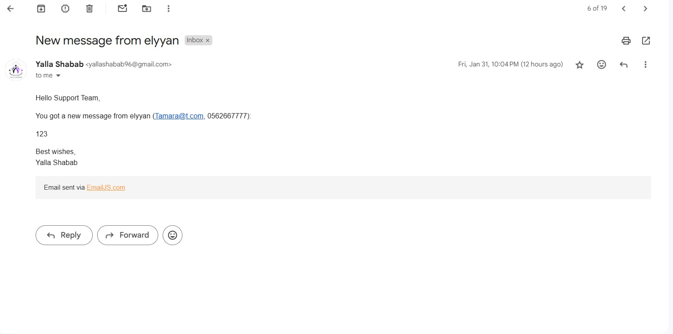
Contact email

